Slide 1
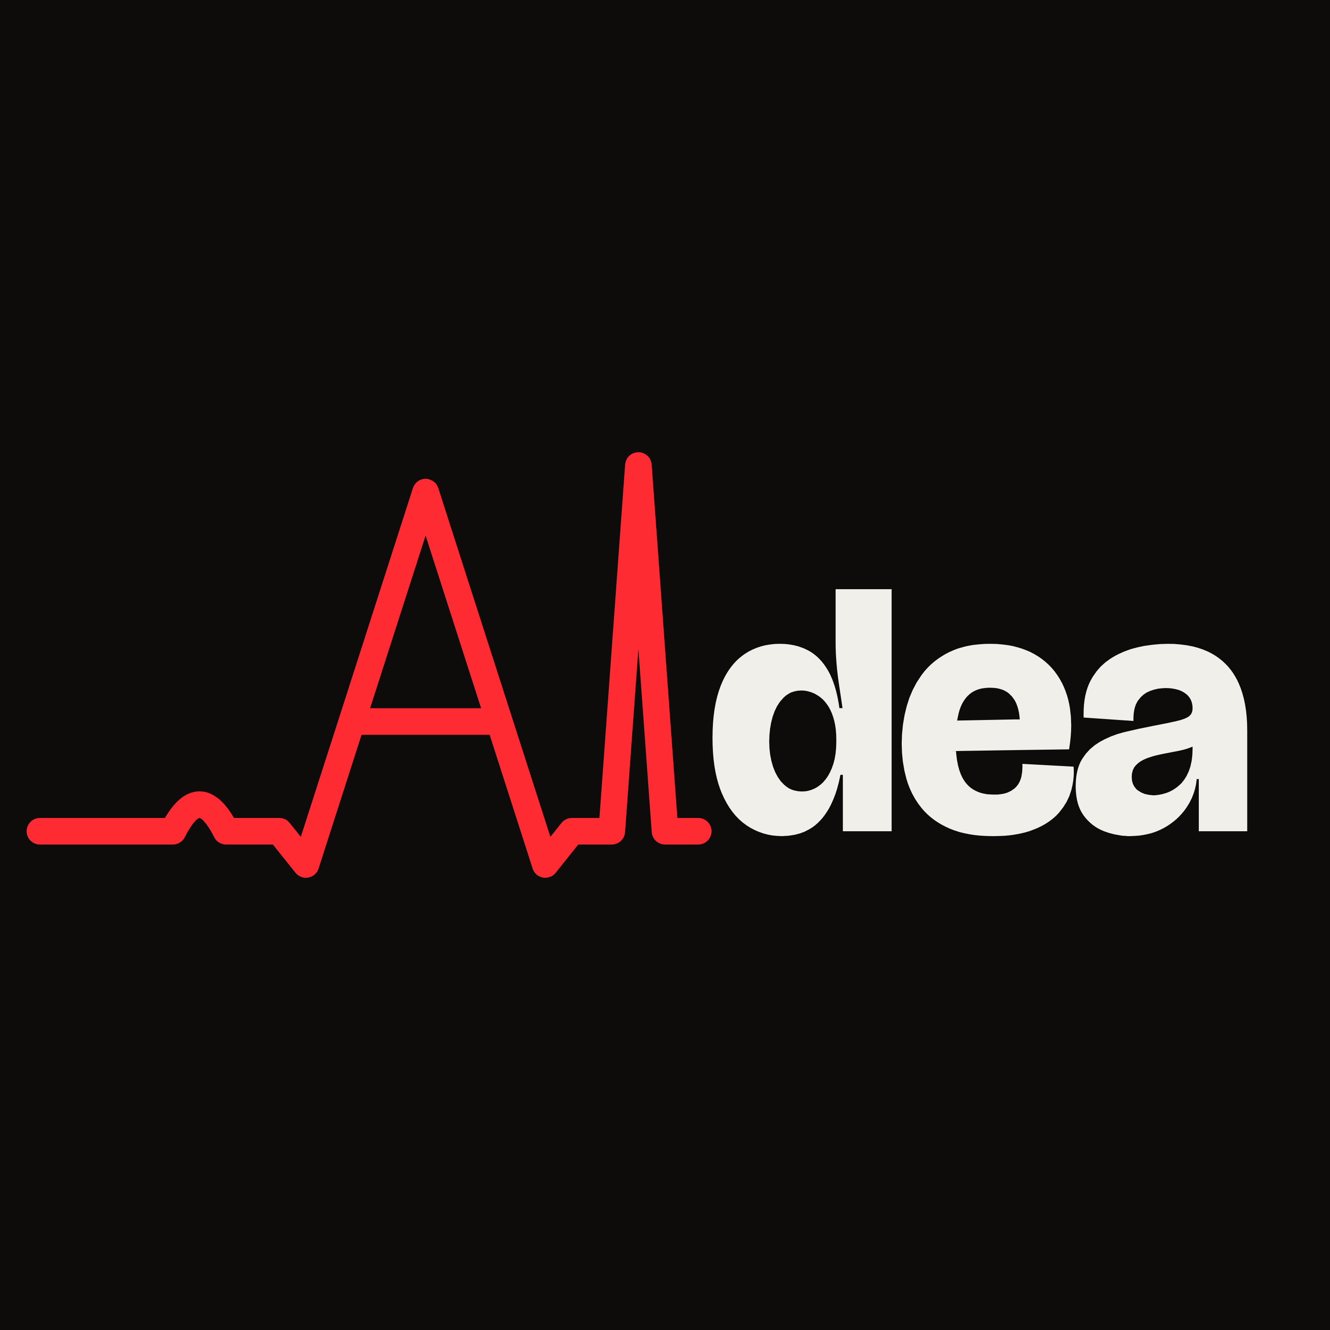
AI news. Every morning. In minutes.
[Team name] · [Event name]
Notes:
Let the logo sit for a moment. Then one line: this is AIdea Daily.

Slide 2
One day of AI news.
7,459
entries, across 41 sources.
Notes:
This is what one ordinary day of AI news looks like. 7,459 entries across the 41 sources we follow. Counted on 11 October 2026.

Slide 3
Of all that,
12
stories were worth your time.
Notes:
Out of 7,459, twelve stories mattered that day. Everything else was repeats, old news, or not about AI at all. That gap is the time people lose.

Slide 4
126 min
Reading just those twelve takes
Two hours. Every day.
Notes:
Even if someone handed you the right twelve, reading the articles behind them takes about two hours. That is 29,018 words at a normal reading speed.

Slide 5
14 min
We turned it into
One episode. Just press play.
Notes:
The same twelve stories, in a fourteen-minute episode you can hear on the way to class or work. Pause after this one.

Slide 6
AIdea Daily
Introducing
The day's AI news, checked and spoken.
Notes:
Introduce the product by name. AIdea Daily: the day's AI news, checked against its sources and read to you.

Slide 7
What you get, every morning.
Listen.
Read.
Trust.
A fresh episode, ready to play.
The same stories as a newsletter.
Every story linked to its sources.
Notes:
Three things every morning. An episode to listen to. A newsletter to read. And the source links for every story, so you can trust it. If there is time, play ten seconds of an episode here.

Slide 8
Every sentence
traced to a source.
Every name and number is checked against the original articles.
Notes:
This is what makes it different from asking a chatbot. The script is written only from the source articles, and every name and number in it is checked against them before it is spoken.

Slide 9
How it works.
Gather
Judge
Write
Speak
41 sources, read automatically.
An AI editor picks what matters.
Scripted from the sources alone.
Voiced and ready to play.
Notes:
Four stages, left to right. It gathers from 41 sources. An AI editor judges what matters. It writes the script from the source articles alone. And it speaks the result as a finished episode.

Slide 10
41
12
1
sources
steps
command
Notes:
Under the hood: 41 sources, a twelve-step pipeline, and one command that runs the whole thing from start to finish.

Slide 11
Built with.
Python
SQLite
runs the pipeline
remembers every decision
Claude Sonnet 5.5
Chatterbox Turbo
edits and writes
gives it a voice
Notes:
Four building blocks. Python runs the pipeline. SQLite keeps a record of every decision. Claude Sonnet 5.5 does the editing and writing. Chatterbox Turbo speaks it, running on our own machine. If a judge asks for more depth, this is the slide to stay on.

Slide 12
It runs. Every day.
Not a mock-up.
Making real episodes since 7 October 2026.
Notes:
This is working software. It has run every day since 7 October and produced real episodes from real news. Offer to show the latest one.

Slide 13
Coming next.
Spotify.
Amazon Music.
A host and a guest.
Notes:
Where it goes from here. The show is headed to Spotify and Amazon Music. And the format grows from one narrator to a host and a guest in conversation, which we have already tested.

Slide 14
Fourteen minutes. Caught up.
Thank you.
[Team name] · [Contact or link]
Notes:
End on the promise: fourteen minutes and you are caught up on AI. Say thank you and leave this slide up during questions.

